Slide 1

Project 2
Spark project

Slide 2
CLUSTER CHAMPS
Members:
Mokshesh Jain
Atul Gandhi
Sankriti Sharma
Shivaji Goulikar
Submitted to-
Ajay Singala
GITHUB URL:
https://github.com/Mokshesh19/Project2

Slide 3
Introduction
India is an emerging and developing country (EDC) found in southern Asia. It is the world's largest democracy, and one of the world's fastest growing economies. In 2013 India was the seventh richest country in the world. Estimates suggest that it had grown to become the fifth largest economy in 2020 and is projected to be the third largest world economy after China and the USA by 2025. India is an example of a country that has become richer
In this project, we attempt to provide an insight into India’s transformation from a fully agriculture-based economy into an important Industrial economy.

Slide 4
Objective
This project aims to analyze and generate statistics on Companies Registration data in India over the course of almost sixteen and a half decades(i.e 1857-2020) by utilizing Spark and its components like RDD’S, DataFrames, SparkSQL

Slide 5
Technologies used
1. Oracle VirtualBox : Oracle VM VirtualBox is a free and open-source hosted hypervisor for x86 virtualization, developed by Oracle Corporation
2. HortonWorks Sandbox : The HDP Sandbox makes it easy to get started with Apache Hadoop, Apache Spark, Apache Hive, Apache Hbase etc
3. Hadoop Ecosystem: Apache Hadoop is a collection of open-source software utilities that facilitates using a network of many computers to solve problems involving massive amounts of data and computation. It provides a software framework for distributed storage and processing of big data
4. Apache Spark : Apache Spark is an open-source unified analytics engine for large-scale data processing. Spark provides an interface for programming entire clusters with implicit data parallelism and fault tolerance.
Notes:
Hypervisor- software that creates and runs virtual machines (VMs). A hypervisor allows one host computer to support multiple guest VMs by virtually sharing its resources, such as memory and processing.

Slide 6
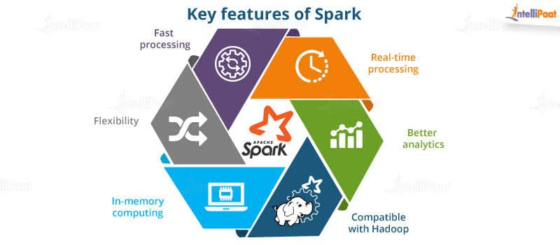
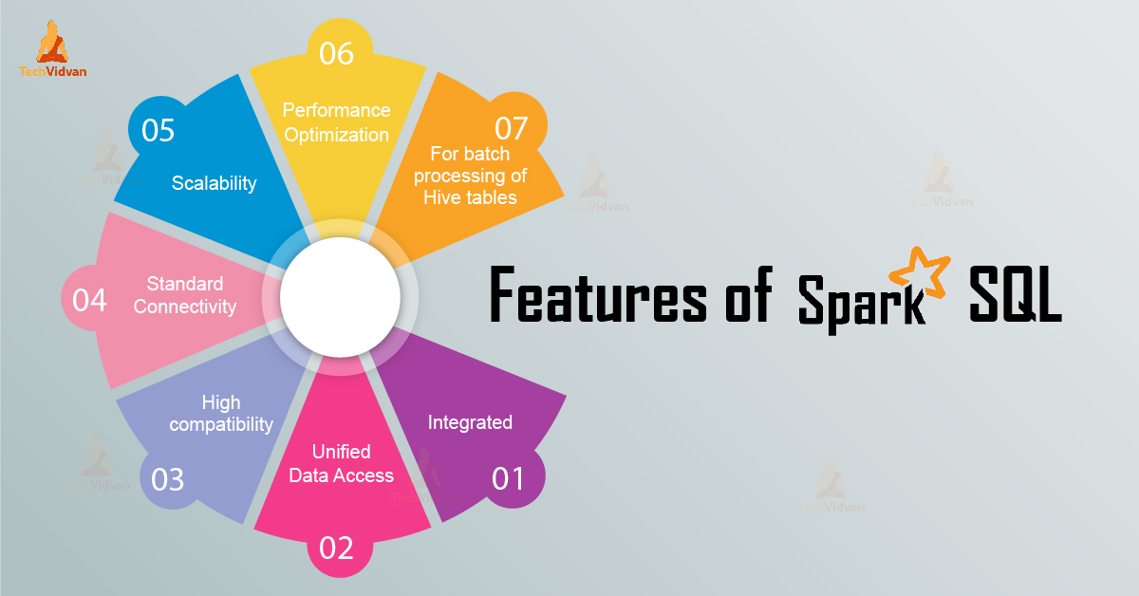
Features

Slide 7
Features
Use of RDD’s and Dataframes
As the code is written in Python and common Sql format like SELECT,FROM,WHERE which makes it easy to read and understand
The dataset is wide and varied in terms of its volume with over 1992170 rows and complexity with over 17 Columns
Notes:
ataFrames (DF) DF are a kind of DataSet, but organized into named columns. Very similar to tables in a RDBMs. But it has a lot of optimization internally. DFs can be constructed from various sources: data files (structured) Hive tables RDDs (existing) external DBs TXT, CSV, JSON, Avro, Parquet, XML (could be from HDFS, S3, Azure Blob storage/filesystem) DF APIs are available in Java, Scala, Python and R DF is an alias of DataSet[row]

Slide 8
Prerequisites
HARDWARE REQUIREMENTS :
1. CPU : 4 logical cores or more that supports virtualization
2. Memory : at least 12GB or more of RAM
3. Storage : 50GB or more of free disk space
4. OS : Windows, Linux , MAC OS

Slide 9
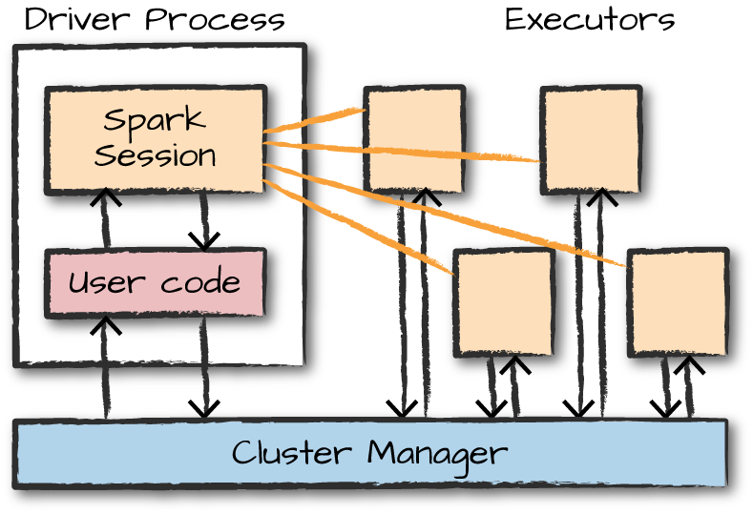
Architecture of SparkSession
Explanation:
>>Driver Process:
The driver is responsible for maintaning application state, running user code and handling user input scheduling and distributing work to executors.
>>Executors:
Executors execute code assigned by the driver and report the state and final results of computation back to the driver.
>>Spark Session:
As part of a driver process, an application must first create a Spark Session. The spark session provides user code with the
primary interface for Spark functionality.
>>Cluster Manager:
Cluster manager is a platform (cluster mode) where we can run Spark. Simply put, cluster manager provides resources to all worker nodes as per need, it operates all nodes accordingly.

Slide 10
STEPS TO BE FOLLOWED

Slide 11
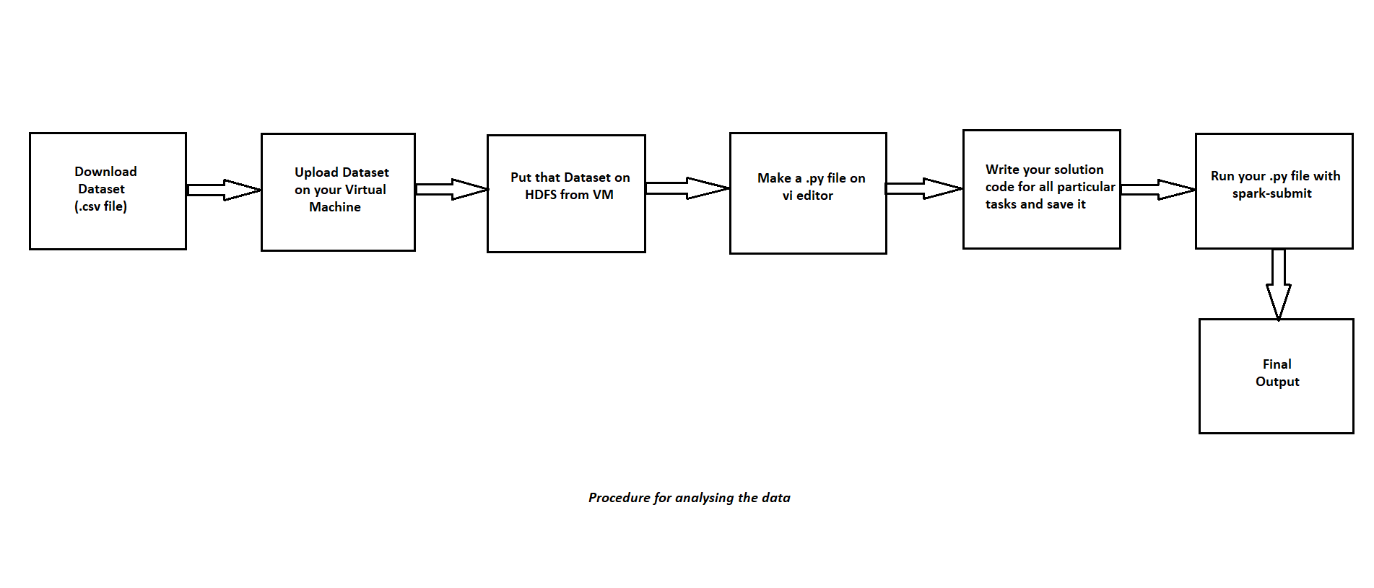
Block Diagram

Slide 12
List Of Queries
Q.1 Total number of companies in each state.
Q.2 Total number of companies of each status. --works
Q.3 Total number of companies in each company class.
Q.4 Total number of companies in each of Principal Business Activities.
Q.5 Total number of companies registered every year.
Q.6 Details of duplicate company names or companies registered more than once.
Q.7 Which are Top 50 oldest companies?
Q.8 Number of companies registered between 1990-2010,2000-2010,2010-2020.
Q.9 List all the private companies which are active in Delhi or Karnataka and has authorized capital greater than 3,00,00,000 INR.
Q.10 List all the public companies which are under liquidation or liquidated in India and belong to State-govt or Union Govt registered after 1985

Slide 13
Cont..
Q.11 LIST THE NUMBER OF THE COMPANIES AND COMPANY CLASS WHICH ARE ACTIVE IN DIFFERENT STATES IN 2020.
Q.12 LIST ALL THE PRIVATE COMPANIES WHICH WERE REGISTERED IN MUMBAI REGISTRAR OFFICE AND ARE VANISHED.
Q.13 LIST 50 RECENTLY REGISTERED COMPANIES.
Q.14 LIST THE PRIVATE(ONE PERSON COMPANY) COMPANIES AND EMAIL ADDRESS OF ITS OWNER REGISTERED IN MUMBAI OR DELHI ROC.
Q.15 LIST ALL THE COMPANIES WHOSE PAIDUP CAPITAL IS GREATER THAN AUTHORIZED CAPITAL.
Q.16 LIST ALL THE PRIVATE (ONE PERSON COMPANY) COMPANIES WHOSE PAID UP CAPITAL IS GREATER THAN 1,00,00,000 INR.
Q.17 LIST THE STATE-GOVT COMPANIES BELONGING TO GUJARAT AND KARNATAKA .
Q.18 LIST THE NUMBER OF OIL COMPANIES IN EACH COMPANY CLASS EVERY YEAR.
Q.19 LIST ALL PRIVATE(ONE PERSON COMPANY) COMPANIES WHICH ARE DORMANT UNDER SECTION 455.
Q.20 LIST THE COMPANIES FROM TAMIL NADU , WEST BENGAL, DELHI WHICH ARE SUBSIDIARIES OF FOREIGN COMPANY.
Q.21 Number of companies which are subsidiaries of foreign company registered every year

Slide 14
Sample Query And Result:
Q) Total number of companies registered every year.
df.groupBy(year("DATE_OF_REGISTRATION").alias("Year"))\
.agg(count("CORPORATE_IDENTIFICATION_NUMBER").alias("no_of_companies"))\
.orderBy("Year").show(1000)

Slide 15
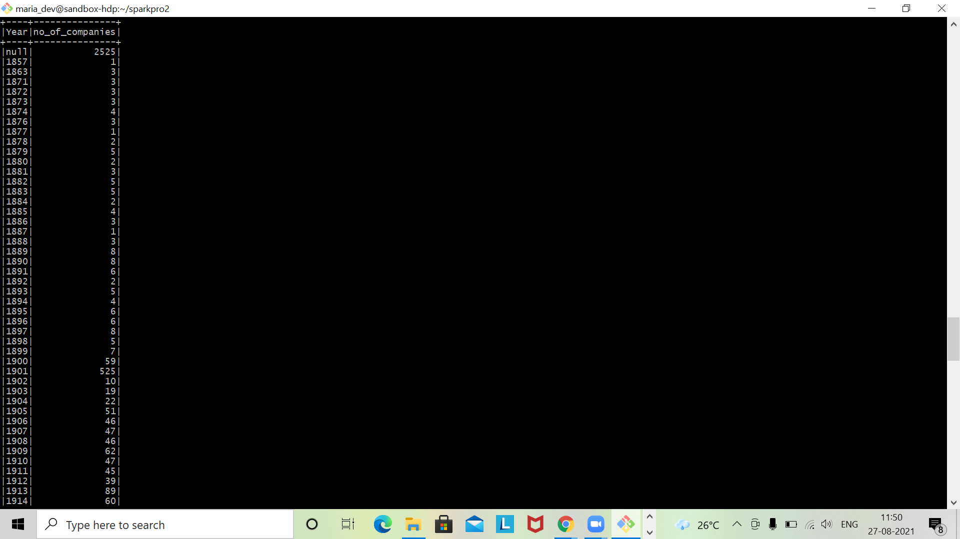
Output

Slide 16
Future Scope
Future is all about big data, and spark provides a rich set of tools to handle real-time the large size of data.
Its lighting, fast speed, fault tolerance, and efficient in-memory processing make Spark a future technology.
Thus, in future, more and more companies will move towards adopting Spark!

Slide 17


